Slide 1
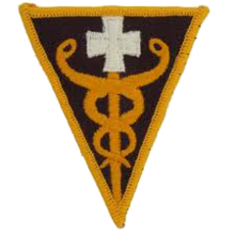

Welcome to Combat Lifesaver
COURSE INTRODUCTION
STAFF INTRODUCTION
UNIFORM
WEAPONS
CELL PHONES
BREAKS & LUNCH
MAINTAIN PROFESSIONALISM
POLICE YOUR AREA
WRITTEN EXAM
HANDS ON

Slide 2
SAFETY BRIEF
ALLERGIES
PROFILES
SMOKE PIT
DIP/CHEW
LATRINES
GRAPHIC CONTENT0

Slide 3
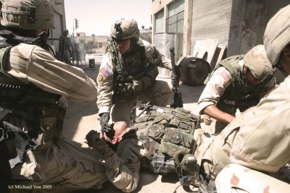
Combat Lifesaver Course
PERFORMING TACTICAL COMBAT CASUALTY CARE
LESSONS 1-2-3

Slide 4
TASK
Tactically manage a simulated casualty.
CONDITIONS
Given a written situation concerning a casualty under combat conditions and possible responses.
STANDARDS
Select the correct response based upon instruction given in Subcourse IS0871

Slide 5
Battlefield Deaths
About 90 percent of combat deaths occur on the battle field before the casualties reach a medical treatment facility (MTF).
Most of these deaths CANNOT be prevented by CLS or medic.

Slide 6
About 15-18 percent of casualties that die before reaching a MTF can be saved
Three major actions that can be taken care of:
Stop severe bleeding from wounds on the extremities (9%)
Relieve tension pneumothorax (5%)
Restore & maintain the casualty’s airway (1%)

Slide 8
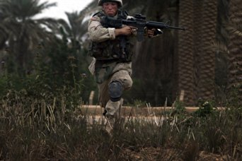
TC3 IS DIVIDED INTO THREE PHASES
First Phase- Care under fire
You are under hostile fire and are very limited as to the care you can provide Return fire as directed or required BEFORE providing medical treatment
Determine if casualty is ALIVE or DEAD!

Slide 9
PERFORMING CARE UNDER FIRE
Provide tactical care to the live casualty
Suppress enemy fire
Use cover or concealment
Direct the casualty to return fire, move to cover, and administer self-aid, if possible. If not have casualty “play dead”
Prevent casualty from sustaining
additional wounds
Reassure the casualty

Slide 10
PERFORMING CARE UNDER FIRE
Communicate the medical situation to team
leader
Tactically transport the casualty, his weapon,
and mission essential equipment to cover
Recheck bleeding control measures as the
tactical situation permits

Slide 11
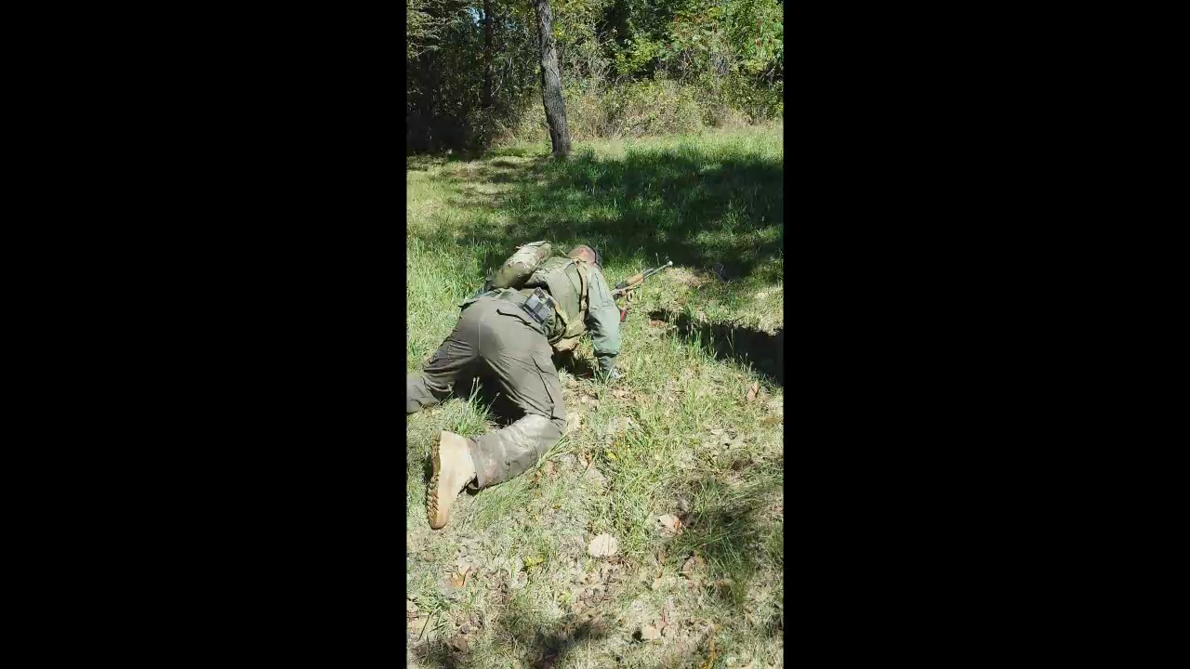

Slide 12
PERFORMING CARE UNDER FIRE
If you can, safely move the casualty and
administer lifesaving care. (Using the
Tourniquet from casualty’s IFAK)

Slide 13
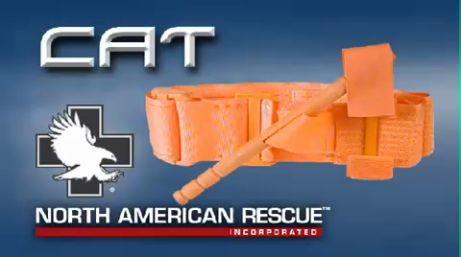

Slide 14
TC3 IS DIVIDED INTO THREE PHASES
Second Phase- Tactical field care
Safe area where you are able to provide
care to the best of your ability
Communicate the medical situation .
Before initiating medical procedures ensure
tactical situation allows time for treatment
General Impression- determine the extent of injuries, chance of survival, and evaluate the tactical situation

Slide 15
Check for responsiveness
Gently shake or tap casualty on shoulder and ask, “Are you okay?”
Check level of consciousness using AVPU scale.
A (Alert) – casualty is talking to you.
V (Verbal) – casualty does not respond to your questions but responds to verbal instruction
P (Pain) – casualty responds to painful stimuli
U (Unresponsive) – casualty doesn’t respond.

Slide 16
PERFORM TACTICAL FIELD CARE
Assess and Secure the casualty’s airway
If the casualty is conscious, able to speak, or not
in respiratory distress, no airway intervention is
needed
If casualty is unconscious, use the head-
tilt/chin lift to open the airway

Slide 17
PERFORM TACTICAL FIELD CARE
Assess and Secure the casualty’s airway (cont.)
Check for breathing:
LOOK for rise and fall of chest/abdomen
LISTEN for sounds of breathing
FEEL for breath on the side of your face

Slide 18
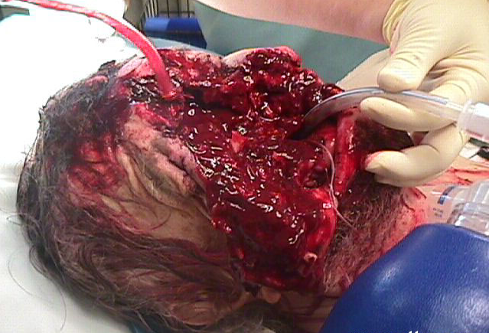

Slide 19
PERFORM TACTICAL FIELD CARE
Chest
Expose and check for equal rise and fall
Check for entrance/exit wounds
Seal any penetrating injuries with airtight material
Monitor the casualty
Position casualty according to treatment provided.

Slide 20
PERFORM TACTICAL FIELD CARE
Bleeding
Apply a tourniquet to major amputation of the
extremity
Apply emergency trauma bandage and direct
pressure to a severely bleeding wound. If
conventional methods do not control bleeding,
apply a tourniquet
If casualty already has a tourniquet, consider loosening tourniquet and using conventional method

Slide 21
PERFORM TACTICAL FIELD CARE
OTHER WOUNDS
Dress all other minor wounds
Remove clothing required to expose and
treat injuries
Protect the casualty from the environment,
hot and cold temperatures, etc
FRACTURES
Splint any obvious long bone fractures

Slide 22
Check for fractured limbs
Part of bone may stick through skin
Experience pain, tenderness, swelling, and/or bruising at site.
Casualty may have heard a “snapping” sound
Difficulty moving arm or leg

Slide 23
Apply splints to the limb, if needed
Use available materials
SAM splints can be used on arm, forearm, or lower leg
Immobilize the joint above and below fracture site when possible
Place padding between rigid object and the casualty’s limb.

Slide 24
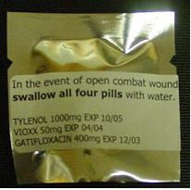
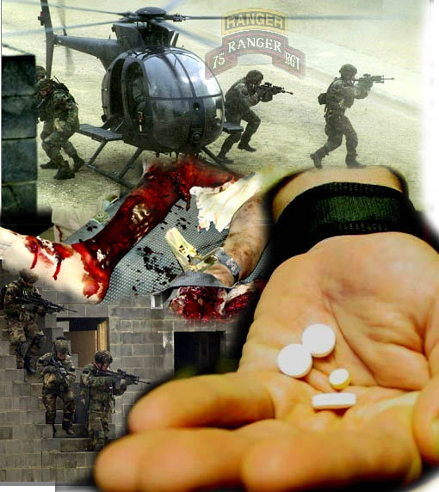
Administer pill pack
Contains pain medications and antibiotics
Have casualty take all four tablets
Treat for shock
Hypovolemic shock is caused by severe blood loss, severe burns, vomiting, diarrhea, and excessive sweating.

Slide 25
Signs & Symptoms of Shock
Sweaty but cool (clammy) skin, pale skin color, and/or blotchy or bluish skin around the mouth.
Nausea
Anxiety
Decrease in the casualty’s level of consciousness
Rapid breathing
Unusual thirst

Slide 26
Treating for Shock
Place in shock position – supine with feet elevated slightly above level of his heart.
Make sure all lower limb fractures are splinted prior to elevating legs.

Slide 27
Treating for Shock
Exceptions to placing casualty in the shock position
Unconscious casualty (should be placed in recovery position)
Suspected spinal fracture or serious head wound (supine without feet elevated)
Open abdominal wound (supine with knees flexed)
Open chest wound (sitting up with back supported or in recovery position with injured side down)
Minor head wound (sitting up with back supported or in recovery position with wounded side up)

Slide 28
Treating for Shock
Place poncho or blanket under casualty.
Take measure to keep casualty from overheating or chilling.
Keep in shade during warm weather.
Cover casualty with Blizzard survival blanket, blanket, poncho, or other available materials in cool weather.
Loosen any binding clothing, including boots
Do not loosen or remove during NBC environment.

Slide 29
Treating for Shock
Reassure casualty & keep him or her calm.
Seek medical help.
Small sips of water are permitted if casualty is conscious.
Evacuate casualty.

Slide 30
Monitor Casualty
Check level of consciousness every 15 minutes
Monitor respirations
Insert nasopharyngeal airway (NPA) if casualty becomes unconscious or breathing rate drops below two respirations every 15 seconds.
Reassess interventions

Slide 31
PERFORM TACTICAL FIELD CARE
FIELD MEDICAL CARD
Initiate DD Form 1380, U.S. Field Medical
Card (FMC) (Being Phased out) or
DA Form 7656, TC3 Card
Document Casualty’s injuries and the
treatment given (Lesson 7)

Slide 32
TC3 IS DIVIDED INTO THREE PHASES
Third Phase- Combat Casualty Evacuation Care
Care is rendered during casualty evacuation
Prepare casualty for evacuation, if needed.

Slide 33
Performing Tactical Combat Casualty Evacuation
Request MEDEVAC (Lesson 8).
Prepare litter if using CASEVAC (Lesson 10).
Continue to monitor casualty during transport.
Evacuate amputated part with casualty
Rinse amputated part free of debris
Wrap it loosely in saline-moistened gauze.
Seal amputated part in plastic bag or cravat.
Place it in a cool container.

Slide 34
PERFORMING COMBAT CASUALTY
EVACUATION CARE
If casualty will be evacuated via CASEVAC, the CLS may accompany the casualty.
CLS must monitor the casualty’s:
ABC’s
Dressings, for stability and reinforce if needed.

Slide 35
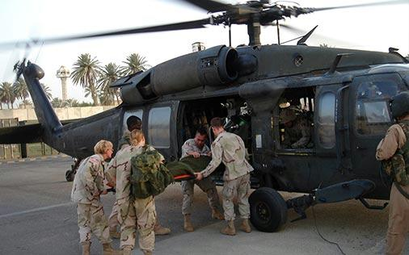
QUESTIONS?

